Slide 1


Slide 2
Teacher’s Introduction:
Most.Asfia Nigar
AssistanTeacher(English)
Baliapukur Vidya Niketon
Boalia,Rajshahi.
Mobile no. 01751815265

Slide 3
Lesson Introduction:
Subject: English 1st Paper
Class: Eight
Unit: 2
Lesson: One
Time: 50 min.
Date:19/01/14

Slide 4
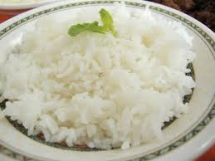
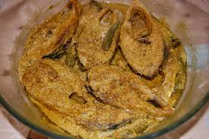
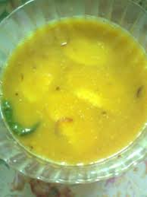
Follow the following pictures
Rice
Fish
Pulse

Slide 5
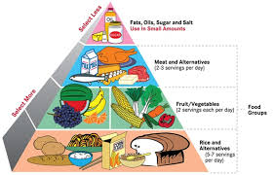
Today’s topic:
Good Food

Slide 6
Objectives of the lesson:
At the end of the lesson we will be able……
to read and understand the text.
      to listen for information.
      to realize the questions and answers.
to write a short paragraph.

Slide 7
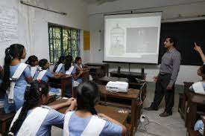
Teacher’s Reading:
Teacher will read the text from unit: Two, lesson-1 frequently and correctly and student will listen.

Slide 8
Student’s Reading:
Student will read the selected text and teacher will listen and also make correction their mistakes.

Slide 9
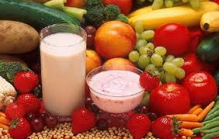
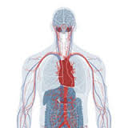
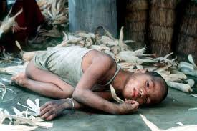
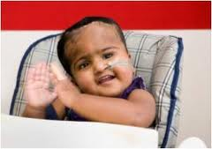
  Word Meaning
Nutritious
পুষ্টিকর
Physical structure
শারিরীক গঠন
Substance
অস্তিত্ব
Healthy
স্বাস্থ্যবান

Slide 10
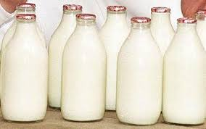
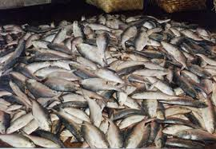
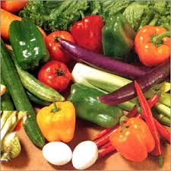
What do you see in the following pictures?
Milk
Vegetable
Fish
The Good Food
Can you guess what the type of food is?

Slide 11
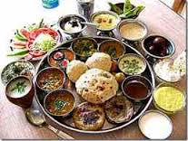
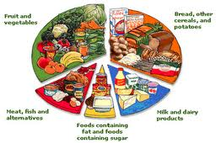
A picture of our regular food
A list of nutritious food

Slide 12
Individual Question: (2 min.)
Write answer of the following questions according to the text
given in the book unit- Two, lesson -1.
Why do we eat food?
Ans:We eat food so that we can live.
(b).What is meant by “nutritious food”?
Ans: “Nutritious food” means that kind of food that contains natural substances for our body and stay healthy.

Slide 13
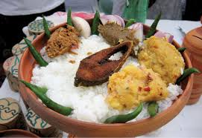
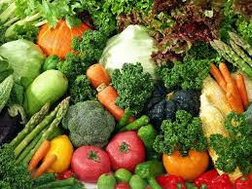
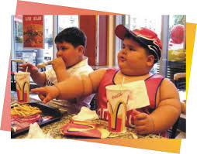
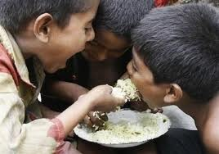
Pair Work: (5 min.)
Identify the following pictures.
Habitual food
Vegetable
A
B
Eating rice
Eating bad food
C
D
Ques: How much food does a person need to eat a day?
Ans: A person needs to eat a day only a certain amount of food that his/her body needs.

Slide 14
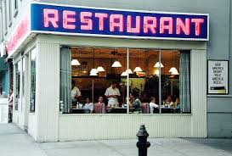
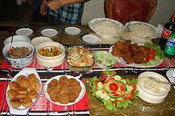
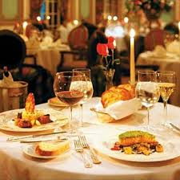
Group Work: (10 min.)
Think you went to eat food to the
restaurant with some friends.
Now, write a comparison paragraph about “Good and Bad Food”.

Slide 15
Evaluation:
What is Ms Rehana talking about?
√
(a)english (b)health (c)food (d)water
2.Our body needs a---amount of food.
√
(a) huge (b) specific (c) scanty (d) large
3. In the passage, “Eating” is used as a/an --
√
(a)verb (b)adjective (c)noun (d)adverb

Slide 16
Home Work:
Write a composition about your favourite food according to the following topics…
definition food.
To get the source of nutritious food.
The necessity of good food.

Slide 17


